Slide 1
UNIT-2
KNOWLEDGE REPRESENTATION
Rules of inference

Slide 2
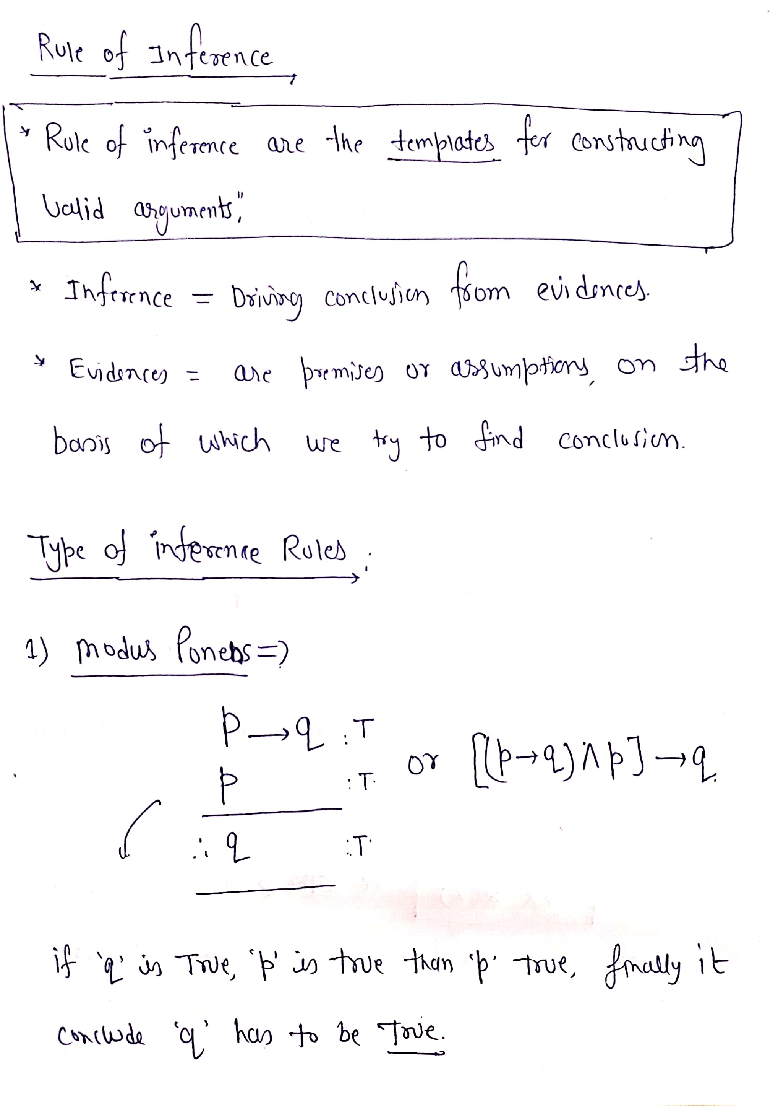

Slide 3
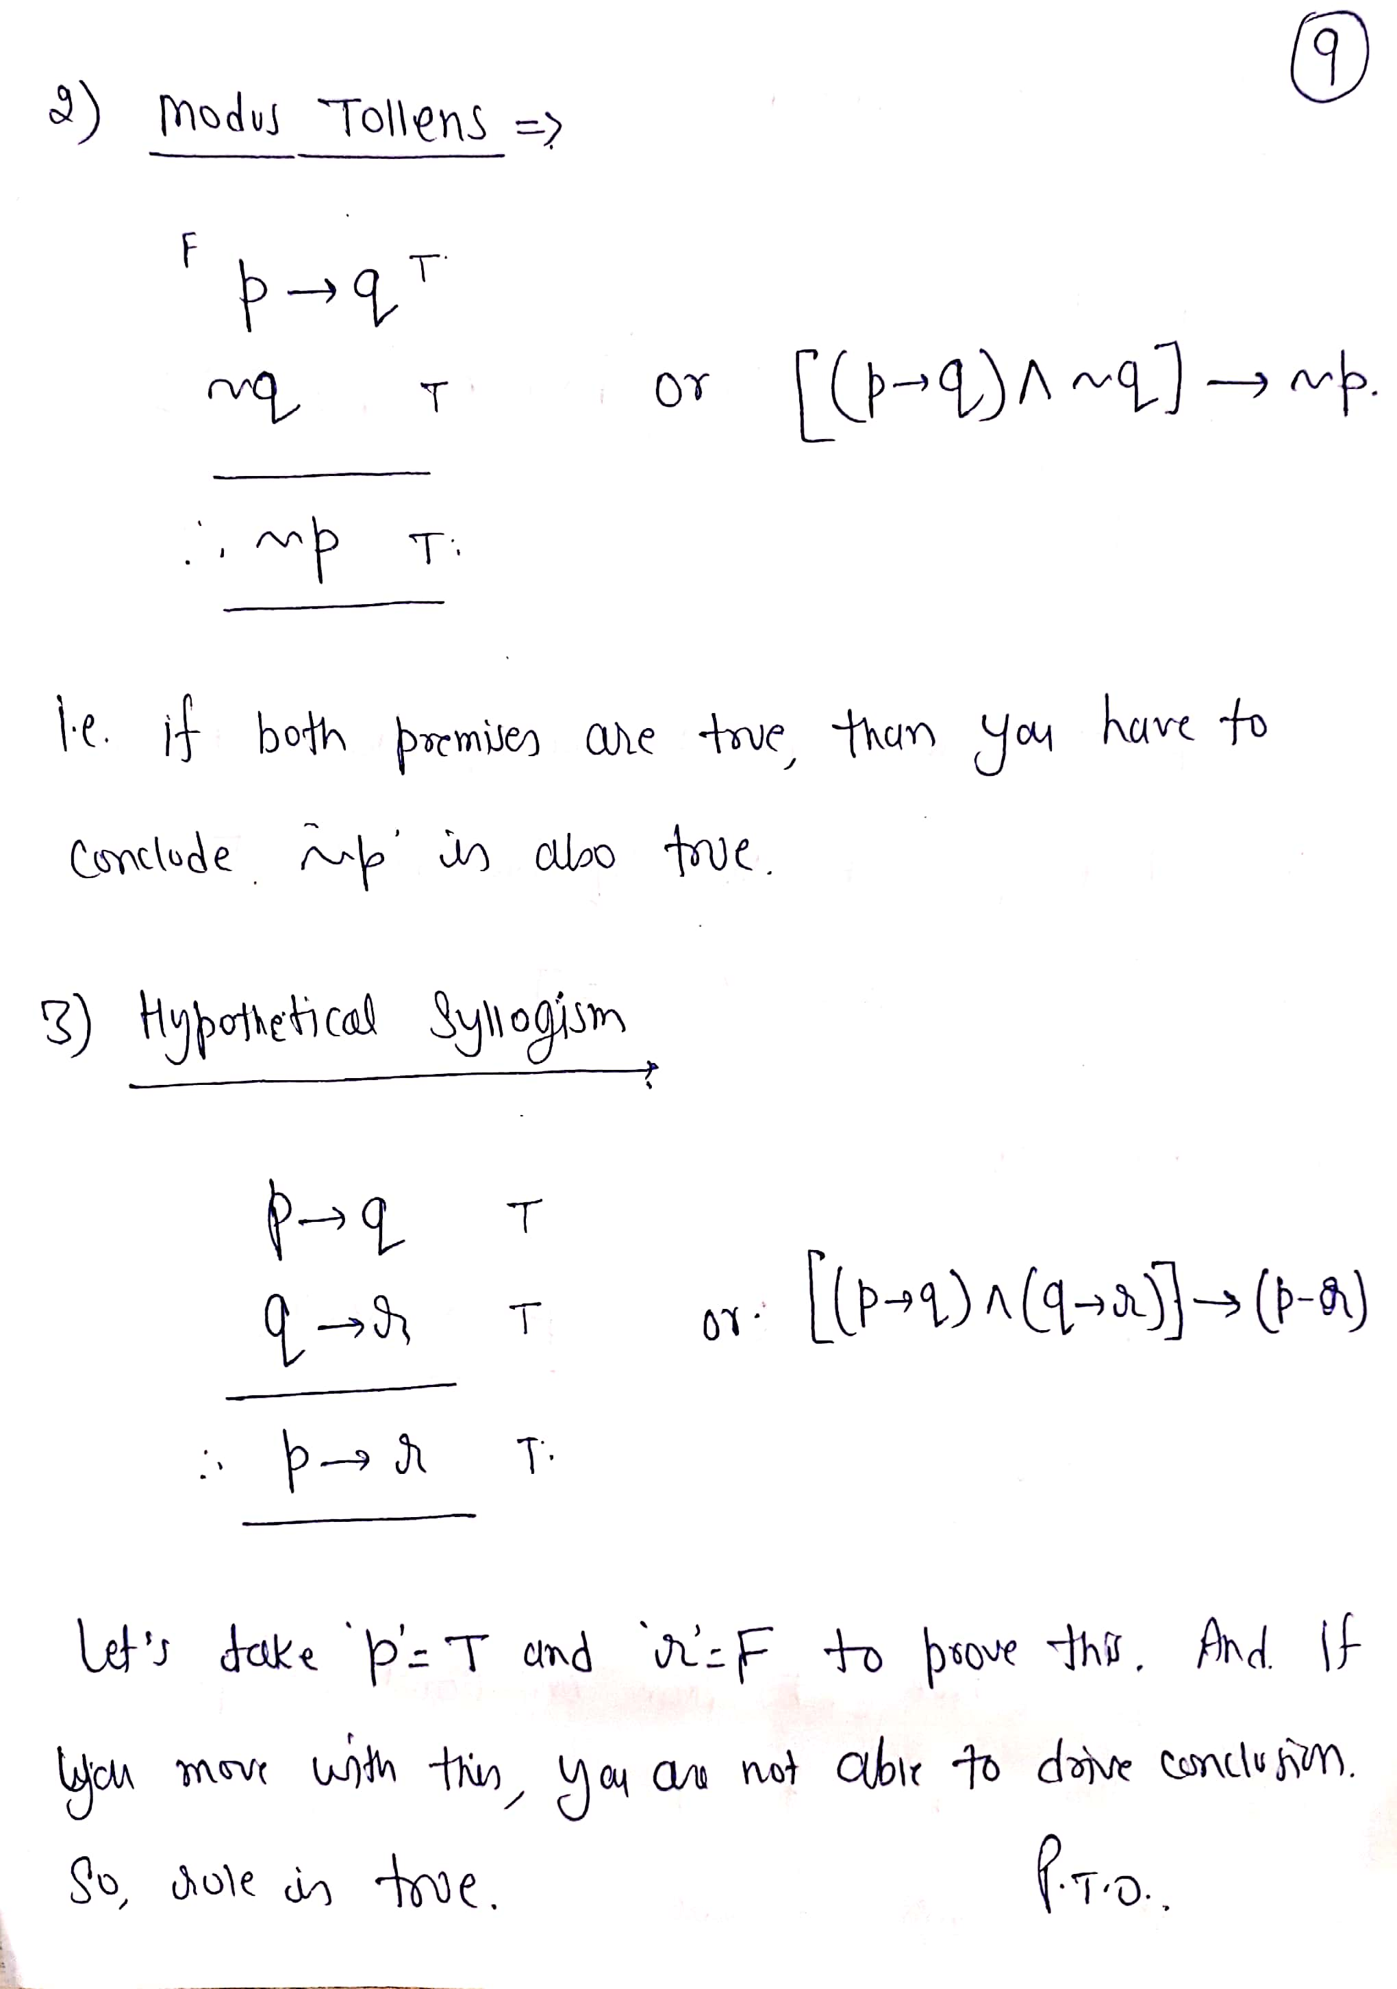

Slide 4
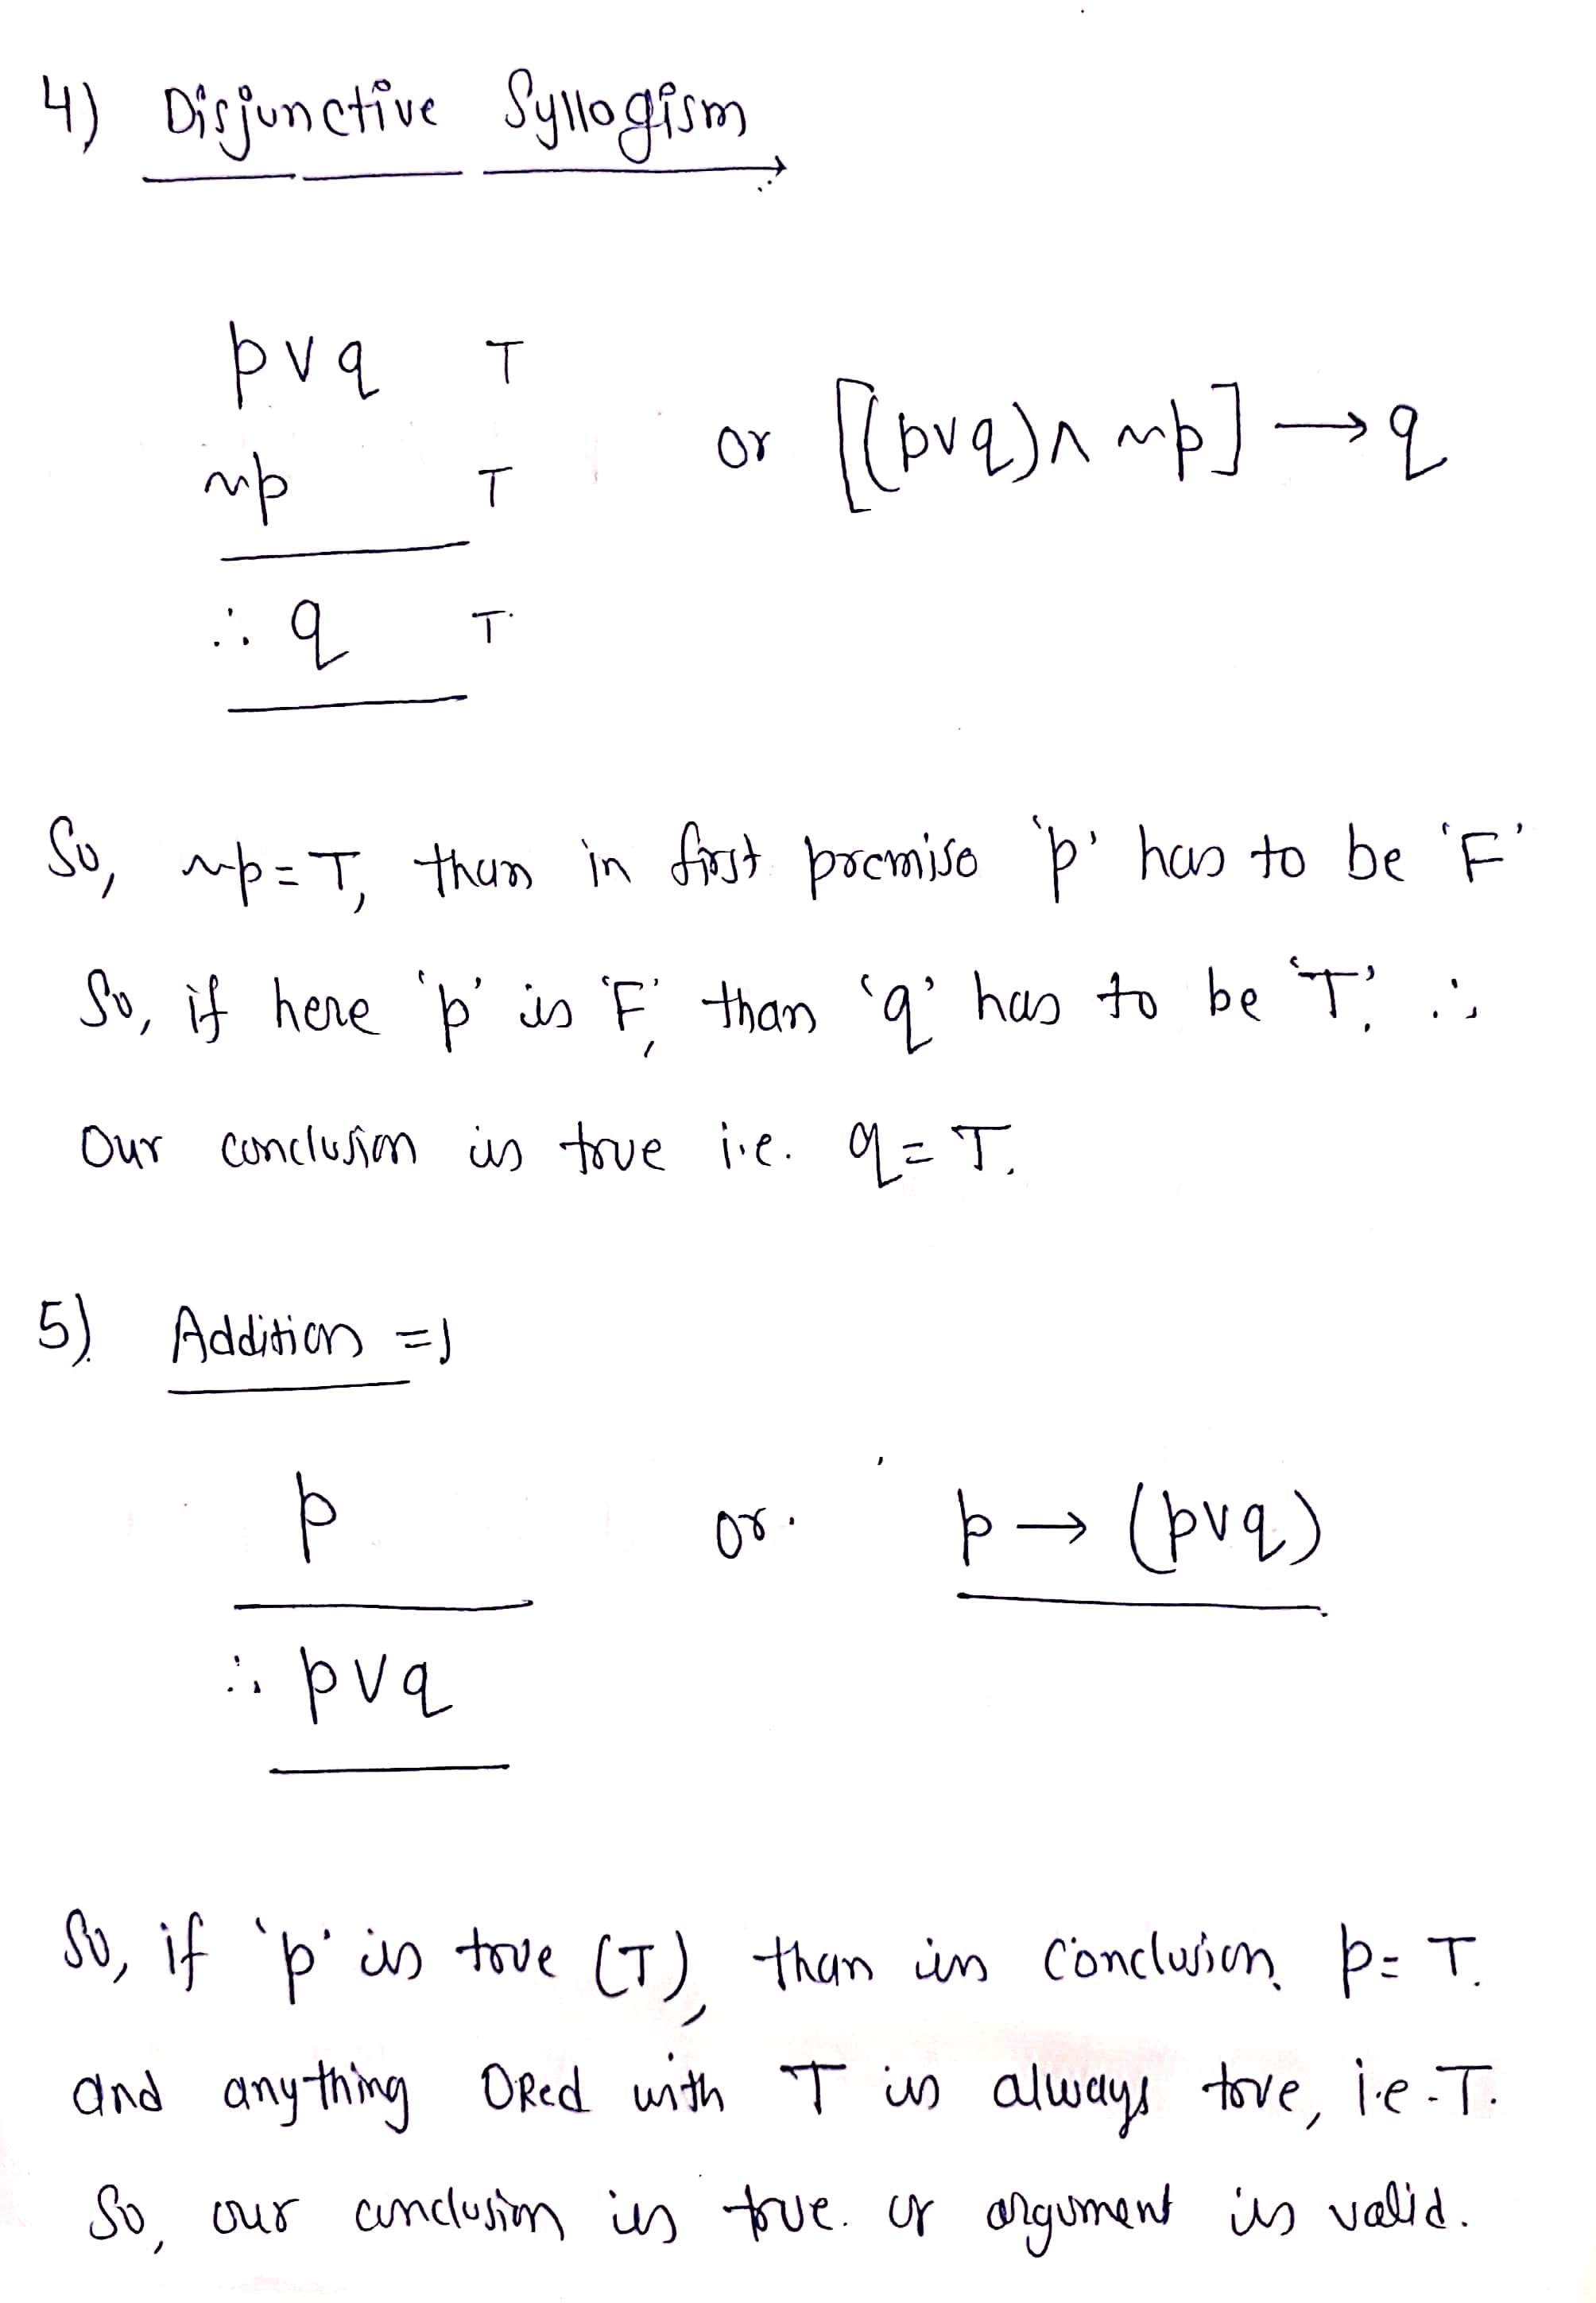

Slide 5
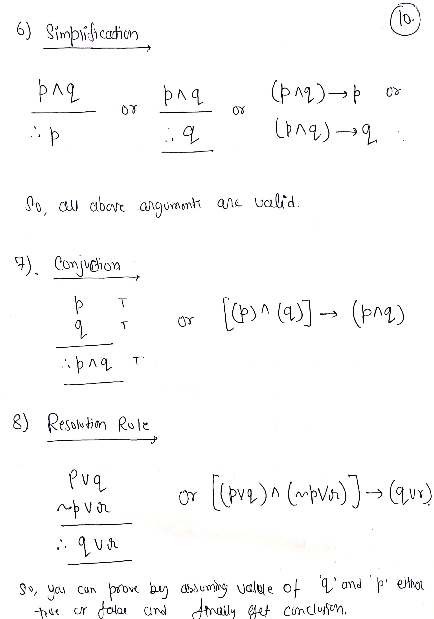

Slide 6
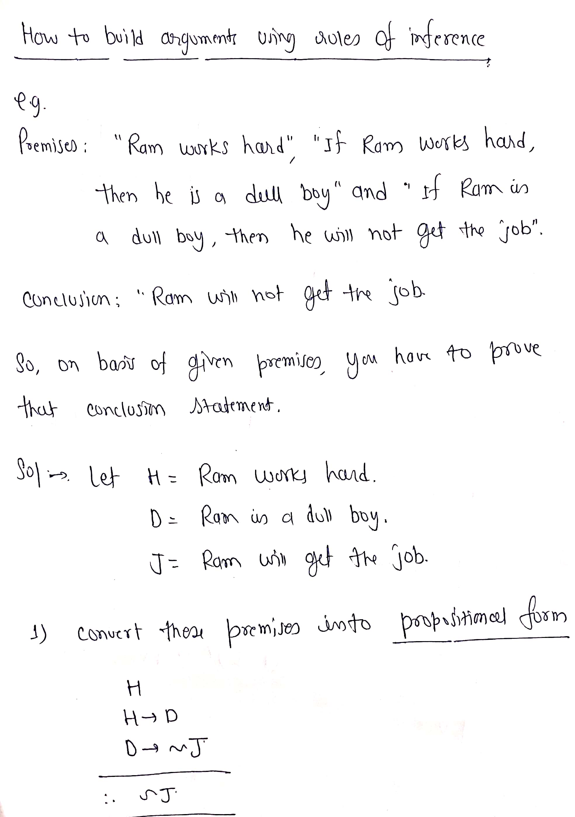

Slide 7
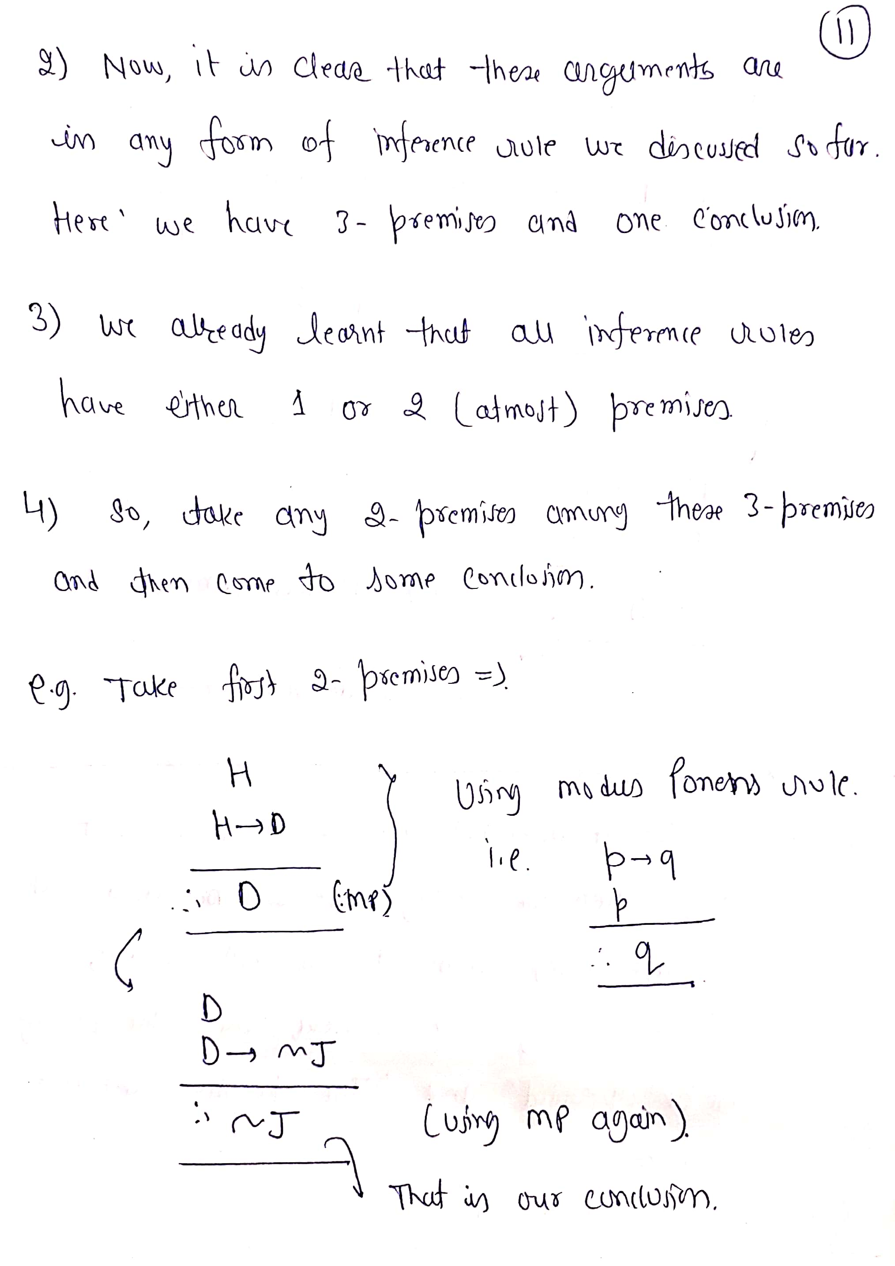

Slide 8
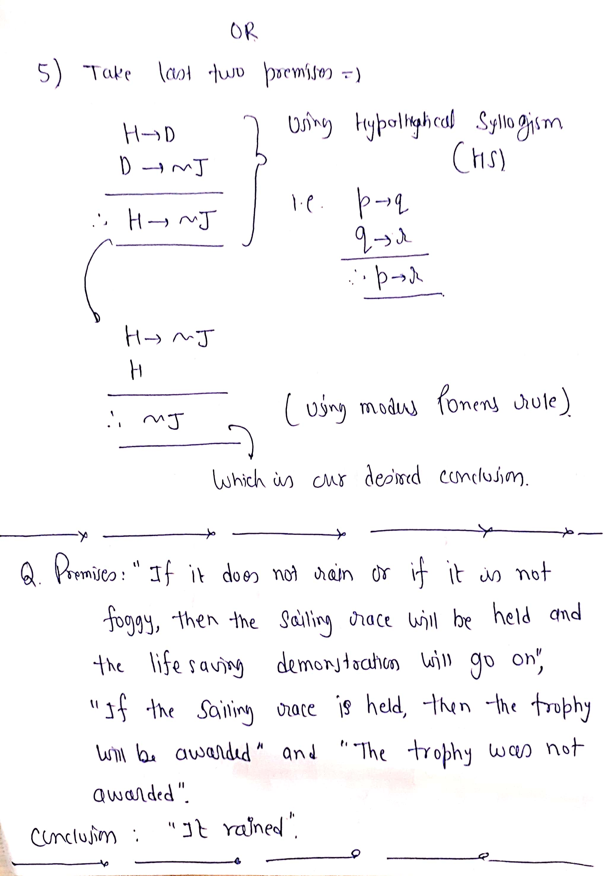

Slide 9
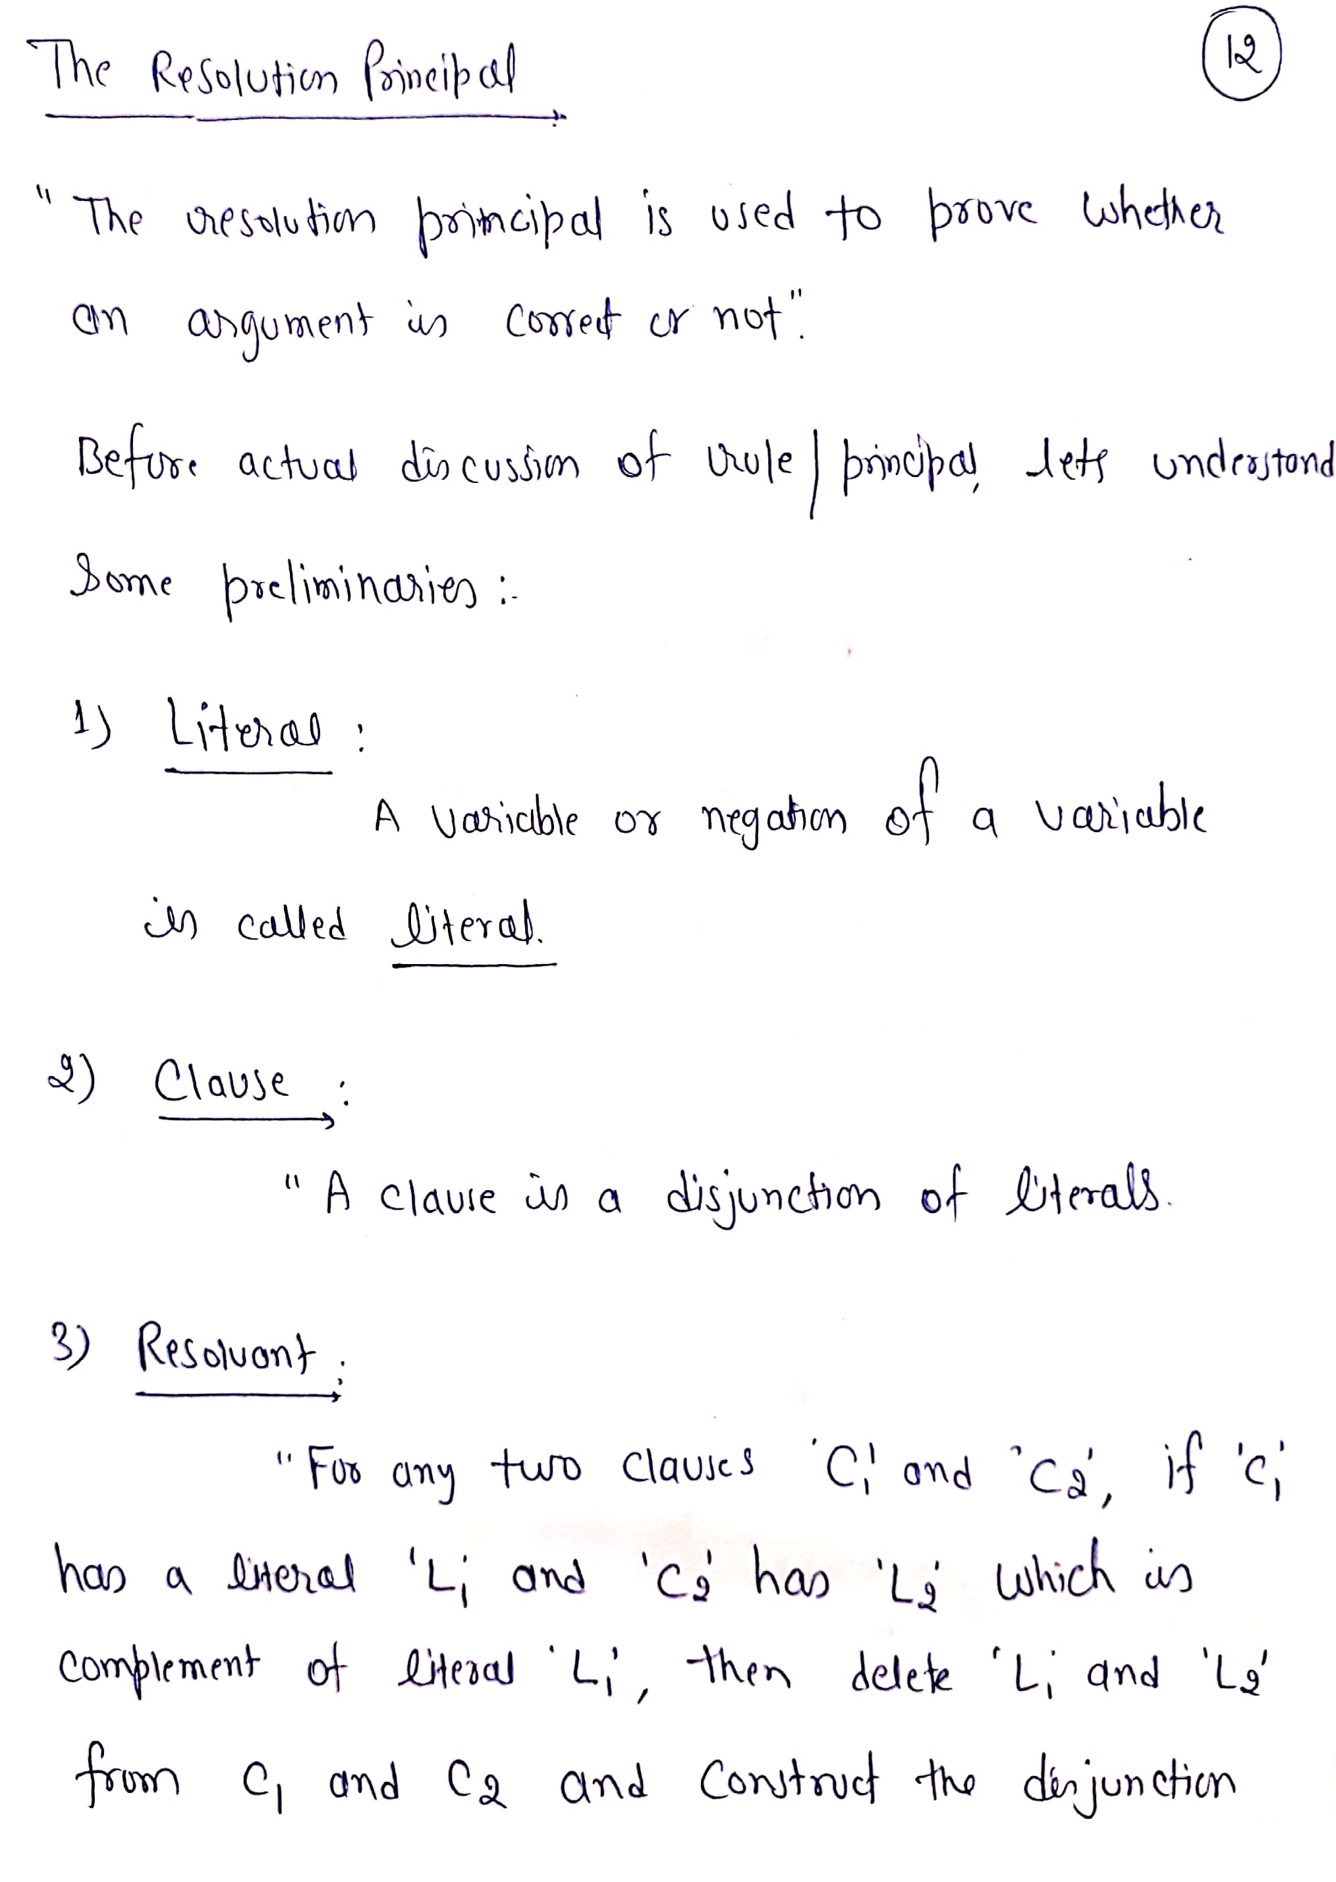

Slide 10
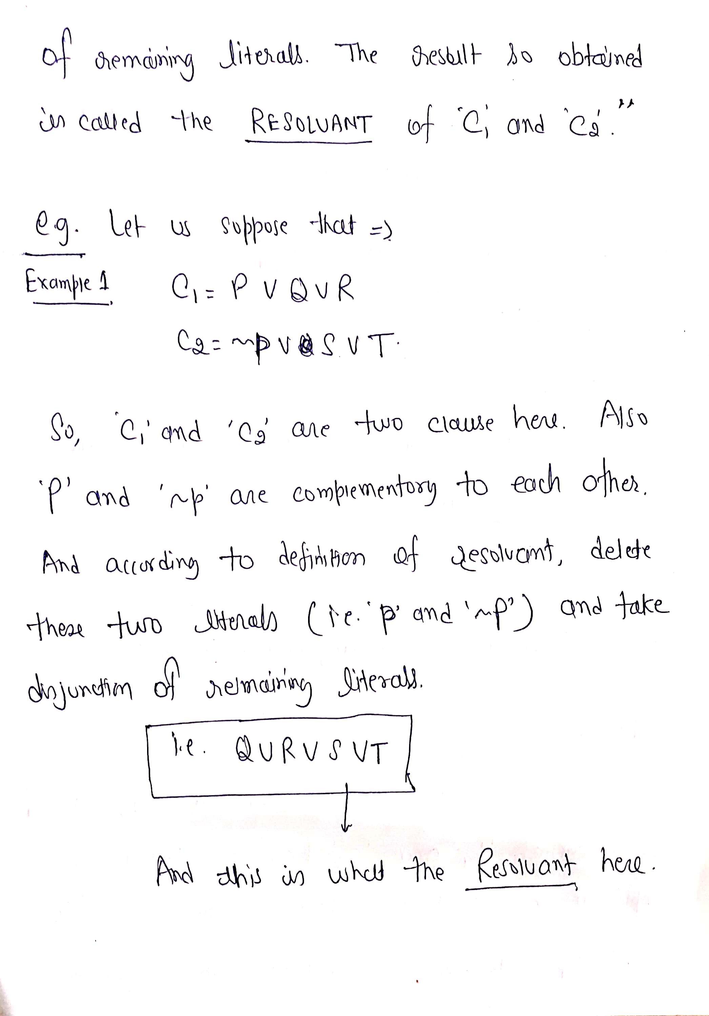

Slide 11
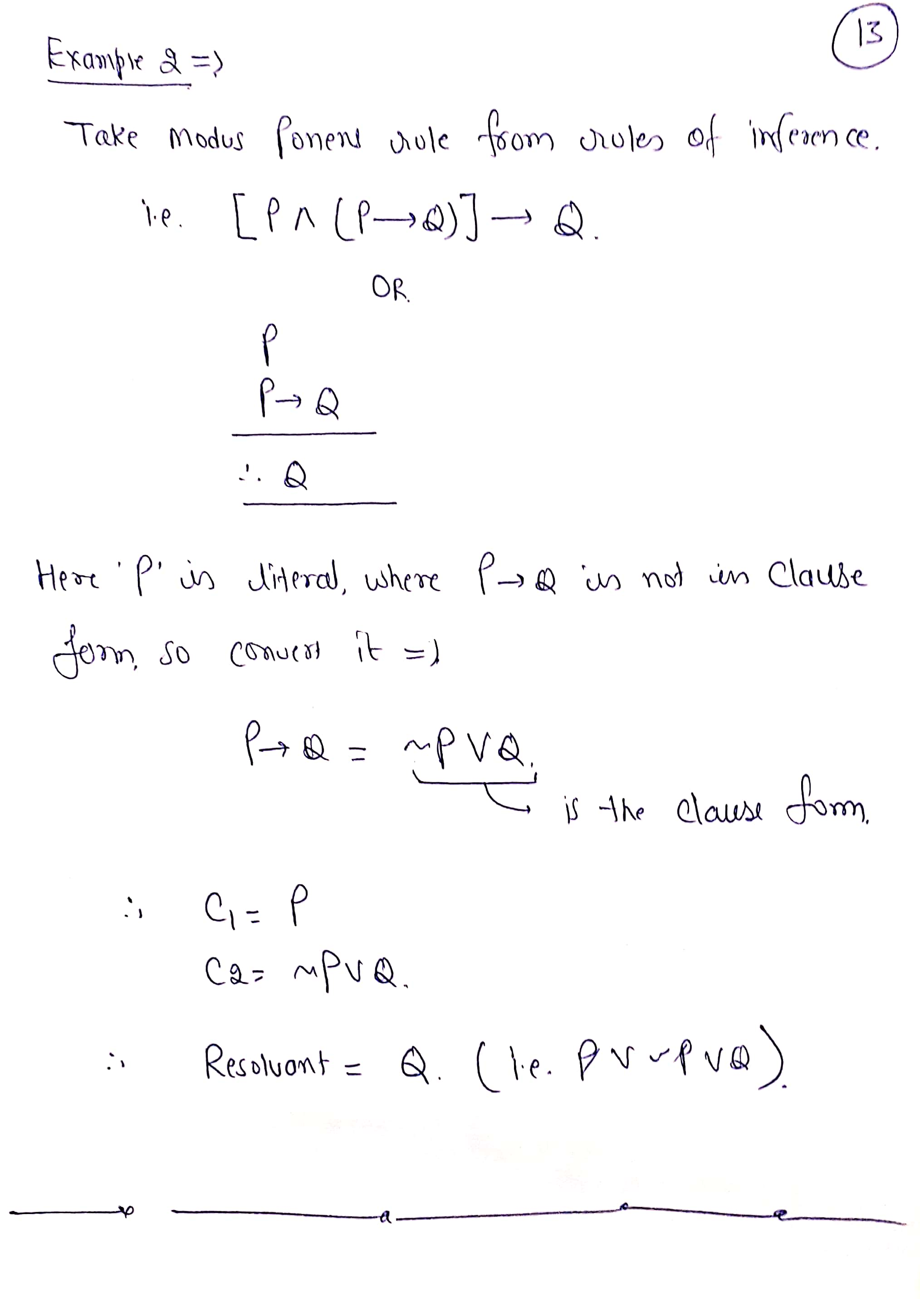

Slide 12
Inference rules:
Inference rules are the templates for generating valid arguments. Inference rules are applied to derive proofs in artificial intelligence, and the proof is a sequence of the conclusion that leads to the desired goal.
In inference rules, the implication among all the connectives plays an important role. Following are some terminologies related to inference rules:
Implication: It is one of the logical connectives which can be represented as P → Q. It is a Boolean expression.
Converse: The converse of implication, which means the right-hand side proposition goes to the left-hand side and vice-versa. It can be written as Q → P.

Slide 13
Contrapositive: The negation of converse is termed as contrapositive, and it can be represented as ¬ Q → ¬ P.
Inverse: The negation of implication is called inverse. It can be represented as ¬ P → ¬ Q.

Slide 14
Rules of inference
The inference rules of propositional logic provide the means to perform logical proofs or deductions.
Rules are
Modus ponens
Modus tollens
Chain rule(Hypothetical Syllogism)
Simplification
Conjunction
Transposition

Slide 15
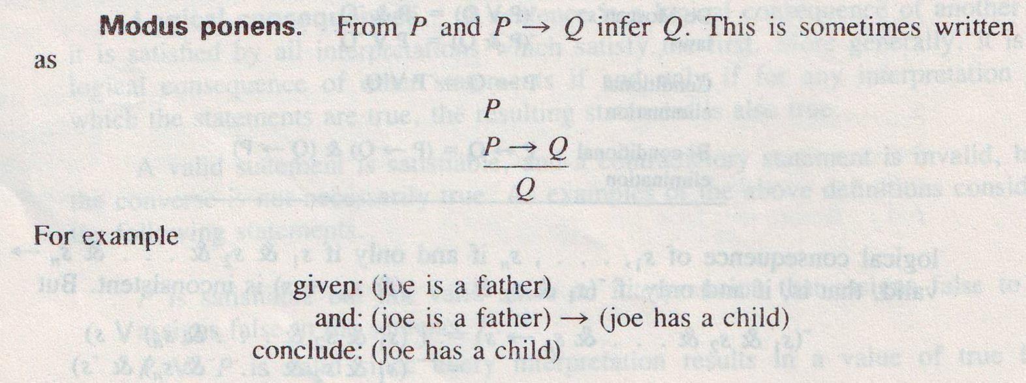
Inference Rules cont………

Slide 16
Inference Rules cont………
Modus tollens
α → β
¬β
¬α
Example:
Given: The machine is defective(α )->the production is less (β)
And : The production is not less (¬β)
Conclude: The machine is not defective (¬α)

Slide 17
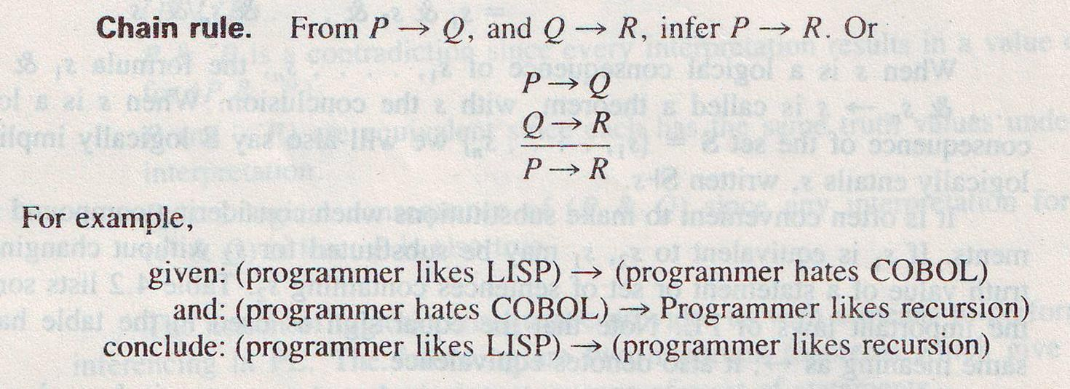
Inference Rules cont………

Slide 18
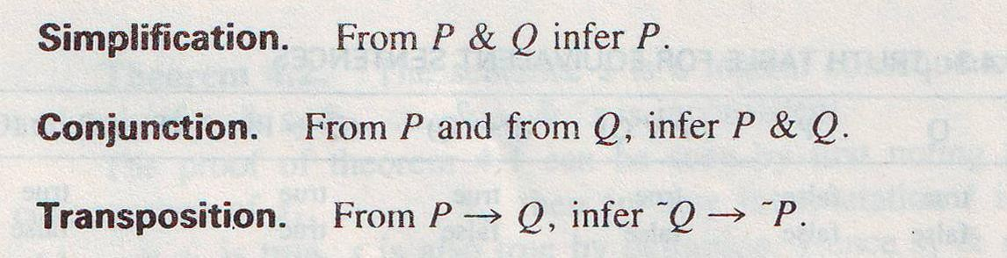
Inference Rules cont………

Slide 19
Resolution Principle
Given two clauses C₁ and C₂ with no variables in common, if there is a literal l₁, in C₁ and which is a complement of a literal l₂ in C₂ , both l₁ and l₂ are deleted and a disjuncted C is formed the remaining reduced clauses. The new clauses C is called the resolve of C₁ and C₂.
Resolution is the process of generating these resolvents from the set of clauses.
Example: (~ PVQ) and (~Q V R)
We can write
(~ PVQ) , (~Q V R)
~P V R

Slide 20
Refutation
Resolution produces proofs by refutation.
In other words, to prove a statement, resolution attempts to show that the negation of the statement produces a contradiction with the known statements.

Slide 21
Example of Resolution
Consider the following clauses:- A : P V Q V R
B: ~ P V Q V R
C: ~Q V R
Solution
A: P V Q V R B : ~P V Q V R D : Q V R
C: ~Q V R E: R
(Given in the problem) (Given in the problem) (Resolvent of A and B) (Given in the problem) (Resolvent of C and D)

Slide 22
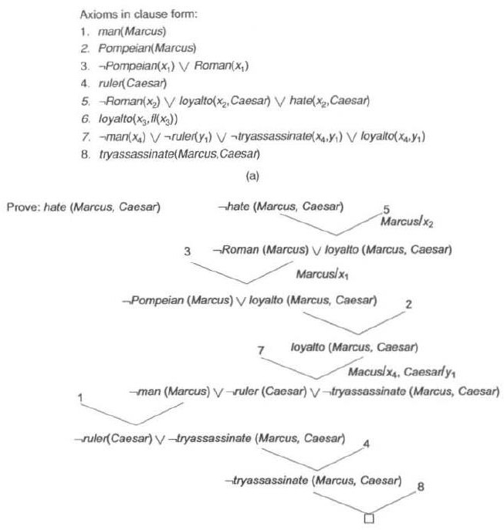

Slide 23
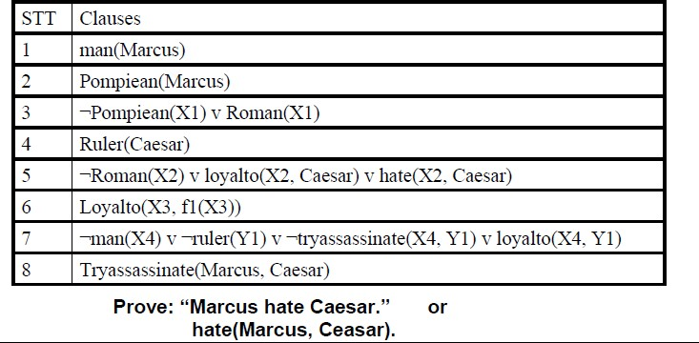
Example of resolution

Slide 24
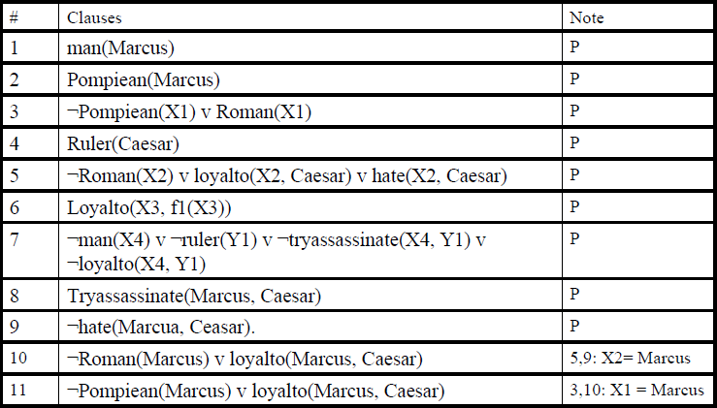
Solution

Slide 25
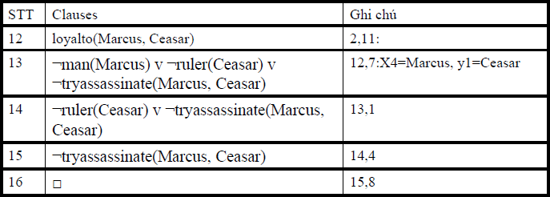
Solution

Slide 26
Example
Assume the following facts:
“Steve only likes easy courses.
Science courses are hard.
All the courses in Humanities Department are easy.
HM101 is a course in Humanities”.
Convert the above statements into appropriate wffs so that the resolution can be performed to answer the question. “ what course would steve like?”

Slide 27
Solution
First we will convert it into FOPL (First order predicate logic)
“Steve only likes easy courses.
∀x: easy(x) -> likes(steve,x)
Science courses are hard.
∀x: science(x) -> ~easy(x)
All the courses in Humanities Department are easy.
∀x: humanities(x) -> easy(x)
HM101 is a course in Humanities”. humanities(HM101)
The conclusion is encoded as likes(steve , x).

Slide 28
Solution continued….
First we put our premises in the clause form and the negation of conclusion to our set of clauses (we use numbers in parentheses to number the clauses):
~easy(x) ∨ likes(steve,x)
~science(x) ∨ ~easy(x)
~humanities (x) ∨ easy(x)
humanities(HM101)
~likes(steve,x)

Slide 29
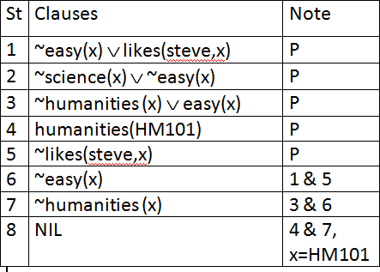
Solution continued….

Slide 30
Solution continued….
A resolution proof may be obtained by the following sequence of resolutions
(6) 1&5 yields resolvent ~easy(x).
(7) 3&6 yields resolvent ~humanities (x).
(8) 4&7 yields empty clause; the substitution x/HM101 is produced by the unification algorithm which says that the only wff of the form likes(steve,x) which follows from the premises is likes(steve, HM101). Thus, resolution gives us a way to find additional assumptions.

Slide 31
Example
Problem Statement:
Ravi likes all kind of food.
Apples and chicken are food
Anything anyone eats and is not killed is food
Ajay eats peanuts and is still alive
Rita eats everything that Ajay eats.
Prove by resolution that Ravi likes peanuts using resolution.

Slide 32
Solution
Step 1: Converting the given statements into Predicate/Propositional Logic
∀x : food(x) → likes (Ravi, x)
food (Apple) ^ food (chicken)
∀a : ∀b: eats (a, b) ^ killed (a) → food (b)
eats (Ajay, Peanuts) ^ alive (Ajay)
∀c : eats (Ajay, c) → eats (Rita, c)
∀d : alive(d) → ~killed (d)
∀e: ~killed(e) → alive(e) Conclusion: likes (Ravi, Peanuts)

Slide 33
Solution continued…
Step 2: Convert into CNF
~food(x) v likes (Ravi, x)
Food (apple)
Food (chicken)
~ eats (a, b) v killed (a) v food (b)
Eats (Ajay, Peanuts)
Alive (Ajay)
~eats (Ajay, c) V eats (Rita, c)
~alive (d) v ~ killed (d)
Killed (e) v alive (e)
Conclusion: likes (Ravi, Peanuts)

Slide 34
Solution continued…
Step 3: Negate the conclusion
~ likes (Ravi, Peanuts)
Step 4: Resolve using a resolution tree

Slide 35
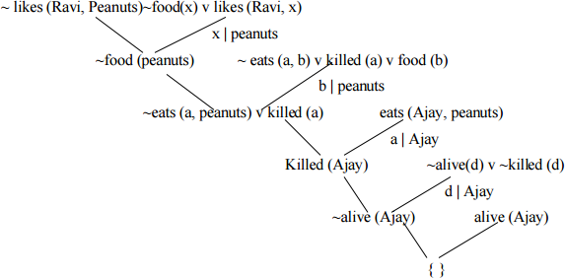
Solution continued…
Hence we see that the negation of the conclusion has been proved as a complete contradiction with the given set of facts. Hence the negation is completely invalid or false or the assertion is completely valid or true.

Slide 36
Thank You

